Slide 1
Cloud Computing in Government and Smart Cities: Digital Governance
Submitted and Presented by
Mr. Nipun Grag
Enrollment No.- A010145024203
MCA Third Semester, Section: E
07th Oct 2025

Slide 2
Index
Introduction
Benefits of cloud computing in government
Digital governance platform
Diffrence between digilocker and e-sewa
Features of digilocker
Benefits of digilocker
Features of e-Sewa
Benefit of e-Sewa
Impact of digital governance
Challenges in digital governance
Smart city inciatives
Practice in digital government
Future outlook
Emerging technologies
Global cooperation
conclusion

Slide 3
Benefits of Cloud Computing in Government
Cloud computing offers numerous benefits to governments, enabling them to deliver better services to citizens while improving operational efficiency.
Here are some key advantages-
Benefit | Description
Improved Efficiency | Enables faster, more effective service delivery through automation and streamlined operations.
Cost Savings | Reduces spending on physical infrastructure and ongoing maintenance.
Scalability | Easily adjusts computing resources based on demand, avoiding overprovisioning.
Enhanced Security | Leverages advanced security tools and compliance standards from cloud providers.

Slide 4

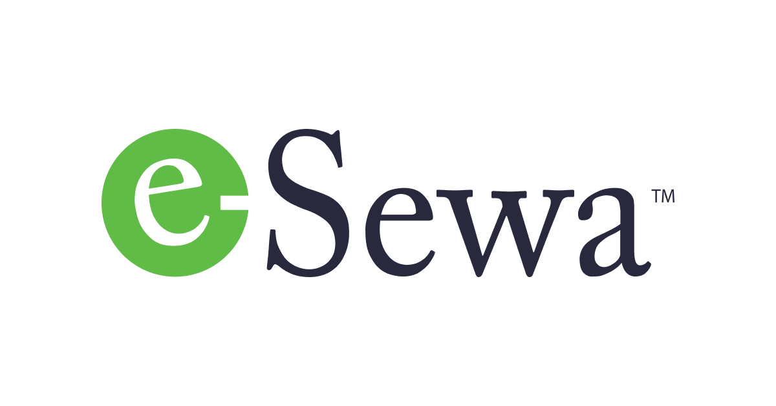
Digital Governance Platforms
Digital governance platforms are revolutionizing the way governments interact with citizens, providing efficient, convenient, and accessible services.
Two significant examples are -
DigiLocker
e-Seva.

Slide 5
Difference between DigiLocker and e-Seva
DigiLocker
e-Seva
Allows users to store, access, and share digital documents
Downloading CBSE certificates, driving license, Aadhaar
Digi-locker is managed by Ministry of Electronics and Information Technology (MeitY)
Provides online services like bill payments, applications, etc.
Paying electricity bills, applying for passports, etc.
Managed by respective state or central government departments

Slide 6
Features of DigiLocker :
DigiLocker is a user-friendly digital platform that offers a range of features to simplify document management for citizens
It allows citizens to store and access important documents digitally, such as- Aadhaar card, driving license ,mark sheets, and other important documents like PAN card, passport.
With DigiLocker, citizens can share documents with government agencies, banks and others.
DigiLocker uses Aadhaar-based authentication to verify the authenticity of documents. This ensures the integrity and validity of the documents.

Slide 7
Benefits of DigiLocker
Feature | Benefit
Digital Storage | Convenience: Access documents anytime, anywhere, via phone or computer
Paperless Access | Time-Saving: No need for physical paperwork or repeated document submission
e-Verification | Increased Security: Ensures document authenticity and prevents tampering
Government Integration | Improved Efficiency: Direct issuance from authorities reduces bureaucracy
Document Sharing | Ease of Use: Share documents with agencies instantly and securely
Aadhaar Integration | Secure Access: Authenticated access ensures only rightful owners retrieve data

Slide 8
Features of e-Sewa:
e-Seva is an innovative e-governance platform that provides citizens with wide range of online services, making it easier to interact with government agencies.
e-Seva enables citizens to access various government services online, including Applying for permits, licenses, and certificates.
e-Seva offers a single window interface that provides access to multiple government services, Submit applications and forms.
e-Seva's payment gateway enables citizens to pay bills and taxes online, making it Convenient to make payments from anywhere.

Slide 9
Benefits of e-Sewa:
Feature | Benefits
Online Service Delivery Apply for permits, licenses, certificates; submit and track applications | - Access services anytime, anywhere - Saves time and effort - Reduces need for physical visits
Single Window Interface One-stop platform for multiple services | - Easy to find and access services - Simplifies process - Improves user experience
Payment Gateway Pay bills and taxes online securely | - Convenient and fast payments - Safe and secure transactions - No waiting in queues

Slide 10
IMPACT OF DIGITAL GOVERNANCE
Digital governance has revolutionized the way governments interact with citizens, providing numerous benefits that enhance the overall quality of life. Here are some key impacts:
Impact Area | DISCRIPTION
Increased Citizen Engagement | Enhances public participation through accessible platforms and real-time interaction
Improved Transparency | Ensures openness in services and decisions, reducing corruption and building trust
Efficient Service Delivery | Streamlines processes for faster, more reliable public service access

Slide 11
Challenges and Opportunities in Digital Governance
As digital governance continues to evolve, it's essential to address the challenges and opportunities that come with it. These are some key areas to focus on:
Security and privacy
Digital divide
Innovation and adoption

Slide 12
Challenges in Digital Governance:
Key Area | Challenges | Opportunities / Solutions
Security and Privacy | Handling sensitive citizen data securely - Risk of data misuse | Implement robust security measures (encryption, access control) - Ensure data transparency - Enforce strong data protection laws
Digital Divide | - Unequal access to digital technology - Lack of digital literacy | - Expand digital infrastructure - Provide affordable digital services - Target marginalized communities
Innovation and Adoption | - Resistance to change - Inadequate infrastructure and skills | Foster a culture of innovation - Invest in digital infrastructure - Offer training and capacity building - Collaborate with private sector

Slide 13
Smart City Initiatives: transforming the urban life
Smart city initiatives are revolutionizing the way cities function, making them more efficient, sustainable, and livable.
Three key components are:
IoT-based Solutions-The Internet of Things (IoT) is the backbone of smart cities, enabling real-time data collection and analysis to optimize urban services.
Data Analytics-Data analytics plays a crucial role in smart city decision-making.
Citizen engagement –citizen engagement is vital to smart city success, fostering a sense of community and promoting participatory governance.

Slide 14
PRACTICES IN DIGITAL GOVERNANCE
The success of digital governance initiatives, it's essential to follow best practices that prioritize collaboration, citizen needs, and continuous improvement.
Foster collaboration between government agencies, citizens, and private sector.
Design digital services with citizen needs and feedback.
Regularly evaluate and improve digital governance platforms.

Slide 15
KEY AREAS | OBJECTIVES
Collaborative Governance | - Leverage expertise and resources from government, citizens, and private sector - Improve decision-making with diverse inputs - Promote transparency and accountability
Citizen-Centric Design | - Improve user experience through intuitive, accessible services - Increase adoption of digital services - Enhance citizen engagement and participation
Continuous Evaluation | - Ensure effectiveness of digital platforms - Identify and fix inefficiencies - Boost citizen satisfaction using feedback and performance data

Slide 16
FUTURE OUTLOOK OF TECHNOLOGIES :
The future of digital governance is exciting, with emerging technologies and trends shaping the landscape.
Like AI, loT

Slide 17
Emerging Technologies
Leverage emerging technologies like AI, blockchain, and IoT to-
Automate processes and improve efficiency through AI and IoT.
Use blockchain to promote transparency and accountability.
Leverage data analytics and AI to inform decision-making.

Slide 18
Increased Adoption
Expect increased adoption of digital governance platforms as:-
Digital Literacy: Digital literacy rates improve, and more citizens become comfortable with digital services.
Convenience: Digital services become more convenient and user-friendly.
Government Support: Governments promote digital governance initiatives and provide support for adoption.

Slide 19
Global Cooperation
Foster global cooperation in digital governance to:
Share Best Practices: Share best practices and expertise across borders.
Address Global Challenges: Collaborate on global challenges like cybersecurity and data protection.
Promote Interoperability: Promote interoperability and standardization across digital governance platforms.

Slide 20
Conclusion and Recommendations
In conclusion, digital governance has the potential to transform public services and citizen engagement.
To realize this potential, governments and policymakers should
Make digital governance a priority and invest in digital infrastructure
Foster collaboration between government agencies, citizens, and the private sector.
Design digital services with citizen needs and feedback.

Slide 21
References
Tom Moddy, “Good Word and Bad Word”, Intelligence Journal, pp. 132 – 133, doi: https://www.doi.org/10.101056/789435
Tom Moddy, “Good Word and Bad Word”, Intelligence Journal, pp. 132 – 133, doi: https://www.doi.org/10.101056/789435
Tom Moddy, “Good Word and Bad Word”, Intelligence Journal, pp. 132 – 133, doi: https://www.doi.org/10.101056/789435
Tom Moddy, “Good Word and Bad Word”, Intelligence Journal, pp. 132 – 133, doi: https://www.doi.org/10.101056/789435
Tom Moddy, “Good Word and Bad Word”, Intelligence Journal, pp. 132 – 133, doi: https://www.doi.org/10.101056/789435
Tom Moddy, “Good Word and Bad Word”, Intelligence Journal, pp. 132 – 133, doi: https://www.doi.org/10.101056/789435
Tom Moddy, “Good Word and Bad Word”, Intelligence Journal, pp. 132 – 133, doi: https://www.doi.org/10.101056/789435
Tom Moddy, “Good Word and Bad Word”, Intelligence Journal, pp. 132 – 133, doi: https://www.doi.org/10.101056/789435
Tom Moddy, “Good Word and Bad Word”, Intelligence Journal, pp. 132 – 133, doi: https://www.doi.org/10.101056/789435

